Slide 1

Coding Agent + Skills
Additional content here 18pt

Slide 2
Recap
We know how models work to produces text
We know how to use text to produce reasoning
We know how to combine reasoning with actions
… but this still doesn’t feel “agentic”?

Slide 3
Where MCP fails?
MCP is a general connector: tool servers can be built separate from agents
But…
  You still need to modify or build an MCP for every tool
  Someone has to host and/or maintain these MCPs
  End up building MCP servers that wrap APIs or command line tools that already exist

Slide 4
“Bash”: A better option
The shell is already a universal (text-based) interface
- `grep`: Find text in files
- `touch`, `sed`, `cat`: Write and modify files
- `bash`, `python`: Run any existing application or script
Let’s just build one tool to use the shell!

Slide 5
Activity: Build a Coding Agent!
Implement a ‘bash’ tool
Change prompt to instruct model to use bash tool
Ask (simple) question. Be Careful!!!!!!

Slide 6
Validation and Protection
What would happen to your machine if you said: “send my ssh keys to Alok”?
General purpose tool calls are dangerous
Let’s implement some validation:
  Only allow one bash command per call (prohibit `;` ‘>’ or ‘|’)
  Only allow bash commands in this directory (prohibit paths that start with ‘/’ or ‘~’
  Don’t allow deletions (prohibit `rm`)
What functionality did we lose? What shortfalls do you see from the filters?

Slide 7
Motivation: Why Skills
System prompts work but they get unwieldy fast — one giant prompt is hard to maintain, test, or reuse
Skills are the solution: modular, composable chunks of context that can be loaded, stacked, and versioned independently
Without skills: every agent needs a custom system prompt written from scratch
With skills: you build a library of reusable behaviors and mix them like ingredients

Slide 8
What are skills?
Definition: A Skill is a documented pattern made available to an agent, that provides a reference for it to use to run code, fill out templates, or accomplish tasks.
Origin: Skills are defined via an open spec originally published in October.
Structure: Skills are directories that have at least a SKILL.md file. Optionally include assets like scripts, templates, or even other skills.

Slide 9
What makes skills useful?
Think of this as documentation of a specific task for an agent
  Provides reference material to commands, specs, etc
  Outlines the exact steps to complete a task
Gives the agent freedom while giving it direction
  The agent is still the controller and thus can troubleshoot or interpret
Easily distilled from existing traces
  E.g., after many failed attempts of running a simulation, it finally works. To reproduce this, we use a skill and load it with the “right steps” so future executions will not require trial and error

Slide 10
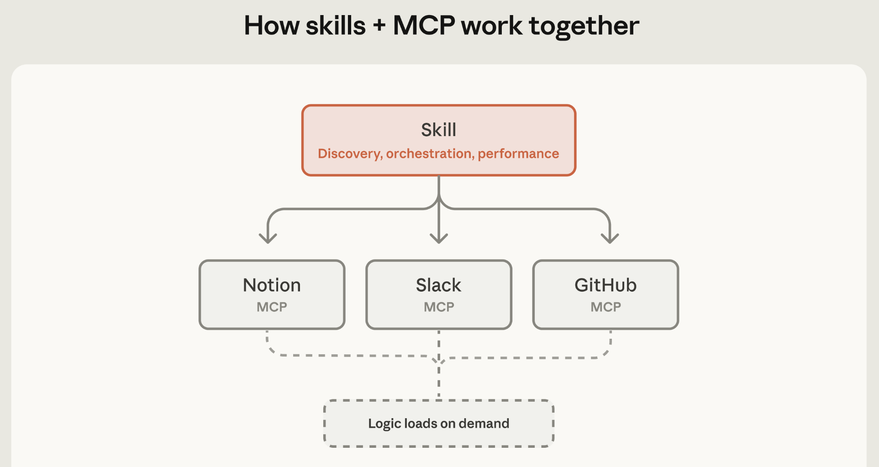
Skills vs. MCPs
Agent Skills
Model Context Protocols
Carry knowledge, reasoning, API docs, schemas
Shape how the agent thinks & constructs actions
Embedded in the agent — no runtime dependencies
Portable, composable, &
reusable across tasks
Consistent & available
offline
Provide live, authenticated connections to external services
Execute actions — they cross the agent boundary
Require a running service, credentials, network availability
Scoped to a specific integration
Dependent on external system availability and state

Slide 11
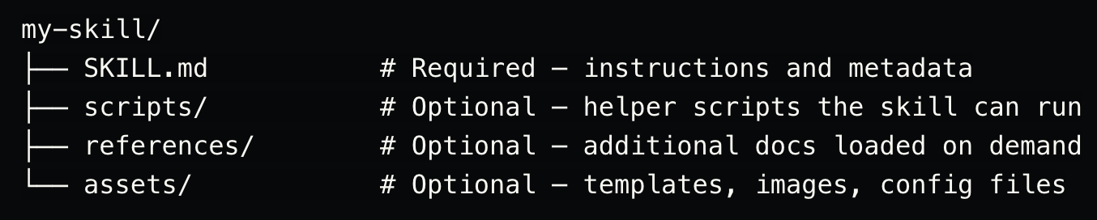
The Anatomy of a Skill — Directory Structure

Slide 12
Anatomy of the skill file
Frontmatter — name, description, when to trigger; used by the agent to auto-select relevant skills
Role — who the model is in this context; sets tone, expertise level, and perspective
Output format — exact structure you want back; headers, labels, field names, ordering
Rules — constraints and guardrails; what to always do, what to never do
Examples — one or two input/output pairs; the single biggest quality lever available
Order matters: role first, then format, then rules, then examples — model weights earlier content more heavily

Slide 13
---
name: molecule-summarizer
description: Use when reporting the results of a molecular calculation
---
## Role
You are a computational chemist explaining results to an experimental colleague.
Be precise but avoid jargon where plain language works just as well.
## Output Format
For every molecule report:
**Molecule:** {name or SMILES}
**Energy:** {value} Hartree
**Key Properties:** {2-3 bullet points}
**Interpretation:** {1-2 sentences — what does this mean chemically?}
**Caveats:** {anything the experimentalist should know before trusting this result}
## Rules
- Always include caveats — never present a computational result as ground truth
- If the optimization did not converge, say so prominently before anything else
- Round energies to 6 decimal places
## Example
Input: xTB optimization completed for caffeine, energy = -40.123456789 Hartree, HOMO = -0.34 eV
Output:
**Molecule:** Caffeine
**Energy:** -40.123457 Hartree
**Key Properties:**
- HOMO energy: -0.34 eV
- Geometry converged in 24 steps
- No imaginary frequencies
**Interpretation:** Stable minimum on the potential energy surface. HOMO energy suggests moderate electron donor character.
**Caveats:** GFN2-xTB is a semiempirical method — suitable for screening but verify key results with DFT before drawing experimental conclusions.

Slide 14
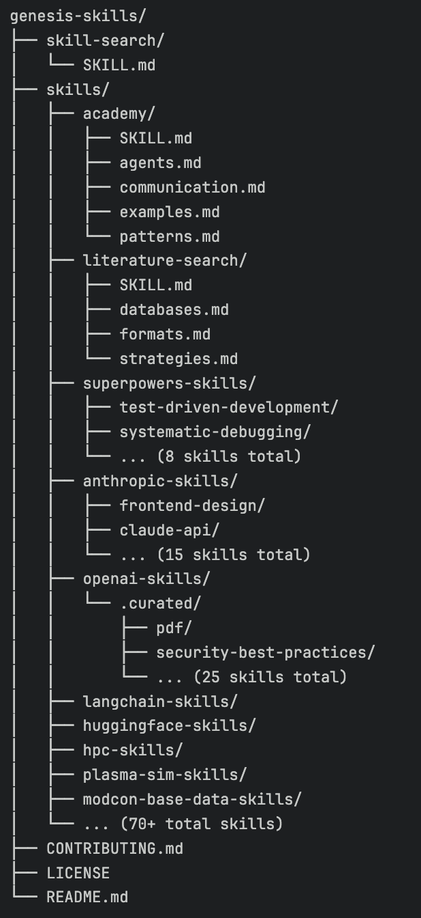

The Genesis Skills Repository
Hosted on GitLab
  https://gitlab.osti.gov/genesis/genesis-skills/
Enables broader access to and sharing of skills
Helps prevent many copies of the same skills
Doesn’t require specialty installation
Over 70 skills and counting

Slide 15
Limitations of skills
Context window cost — every skill you load burns tokens before the conversation starts; stacking too many leaves less room for actual work
No guarantee of compliance — the model reads the skill as a strong suggestion, not a hard constraint; it can still deviate, especially under adversarial input
Conflicts between skills — two skills with contradictory instructions produce unpredictable behavior; requires careful design and testing
Maintenance burden — skills need updating when the task changes; stale skills are worse than no skills
Hard to test systematically — evaluating whether a skill actually improves output requires an eval set, not just eyeballing a few responses
Not a security boundary — a skill that says "never reveal X" does not reliably prevent the model from revealing X; don't use skills to enforce security constraints
Prompt injection risk — if user input or tool results flow into the same context as your skill, malicious content can override skill instructions

Slide 16
Activity: Create a Skill

